Slide 1
MODULE 1
IPR: INTRODUCTION AND HISTORICAL OVERVIEW

Slide 2
BRIEF OUTLINE
Introduction
Conventions on IPR
IPR in the Multilateral Framework
Concluding Observations

Slide 3
INTRODUCTION
Intellectual property (IP) is the creations of the human mind
The legal rights that protect these creation of minds are known as the Intellectual property rights (IPRs)
IPRs provide its owner the time-bound right to prevent others from using their intellectual property based on pre-defined and legalized criteria

Slide 4
IPRS:TWO MAIN AREAS
IPRs are normally separated into two main areas:
(a) Copyright and rights related to copyright
(b) Industrial property.

Slide 5
PARIS CONVENTION
The Paris Convention, adopted in 1883
It applies to industrial property in the broader sense, including patents, trademarks, industrial designs, utility models, service marks, trade names, geographical indications and the control of unfair competition
This international agreement was aimed at ensuring the protection of intellectual works in other countries and was the first major step to help the creators
For details follow the link: http://www.wipo.int/treaties/en/ip/paris/summary_paris.html

Slide 6
THE BERNE CONVENTION
The Convention was accepted in 1886
It was adopted to protect the works and the rights of their authors
The Convention deals with providing the authority and the terms and conditions to control the artistic and other similar works of authors, poets, musicians, etc.
It has the provisions to grant the minimum protection
It also provides special provisions that are mandated for the developing countries
For details follow the link: http://www.wipo.int/treaties/en/ip/berne/summary_berne.html

Slide 7
ROME CONVENTION
The Rome Convention,1961
It protects Performers, Producers of Phonograms and Broadcasting Organizations
WIPO is mandated for the enforcement of the Rome Convention together with the ILO and the UNESCO
For more details on Rome Convention, follow the link: http://global.oup.com/booksites/content/9780198259466/15550004

Slide 8
OTHER CONVENTIONS AND TREATIES
Sr. No. | Convention/Treaties | Year
1 | Brussels Convention | 1974
2 | Washington Treaty | 1989
3 | Trademark Law Treaty (TLT) | 1994
4 | WIPO Copyright Treaty (WCT) | 1996
5 | Patent Law Treaty (PLT) | 2000
6 | Singapore Treaty on the Law of Trademarks | 2006

Slide 9
BRUSSELS CONVENTION 1974
The Brussels or Satellites Convention provides for the obligation of each Contracting State to take adequate measures to prevent the unauthorized distribution on or from its territory of any programme-carrying signal transmitted by satellite.

Slide 10
WASHINGTON TREATY 1989
The Washington Treaty was adopted in 1989 and provides protection for the layout designs (topographies) of integrated circuits.
The Treaty has not yet entered into force, but has been ratified or acceded to by the following States: Bosnia and Herzegovina, Egypt and Saint Lucia.

Slide 11
TRADEMARK LAW TREATY (TLT) 1994
The aim of the Trademark Law Treaty (TLT) is to standardize and streamline national and regional trademark registration procedures.
This is achieved through the simplification and harmonization of certain features of those procedures, thus making trademark applications and the administration of trademark registrations in multiple jurisdictions less complex and more predictable.

Slide 12
WIPO COPYRIGHT TREATY (WCT) 1996
The WIPO Copyright Treaty (WCT) is a special agreement under the Berne Convention which deals with the protection of works and the rights of their authors in the digital environment.
In addition to the rights recognized by the Berne Convention, they are granted certain economic rights.
The Treaty also deals with two subject matters to be protected by copyright: (i) computer programs, whatever the mode or form of their expression; and (ii) compilations of data or other material ("databases").

Slide 13
PATENT LAW TREATY (PLT) 2000
The Patent Law Treaty (PLT) was adopted in 2000 with the aim of harmonizing and streamlining formal procedures with respect to national and regional patent applications and patents and making such procedures more user friendly.
With the significant exception of filing date requirements, the PLT provides the maximum sets of requirements the office of a Contracting Party may apply.

Slide 14
SINGAPORE TREATY ON THE LAW OF TRADEMARKS 2006
The objective of the Singapore Treaty is to create a modern and dynamic international framework for the harmonization of administrative trademark registration procedures.
Building on the Trademark Law Treaty of 1994 (TLT), the Singapore Treaty has a wider scope of application and addresses more recent developments in the field of communication technologies.

Slide 15
IPR IN THE MULTILATERAL FRAMEWORK
Intellectual property rules were introduced into the multilateral trading system for the first time under the GATT/WTO
Trade-Related Aspects of Intellectual Property Rights (TRIPS) was negotiated in the Uruguay Round during 1986-94
For more details on TRIPS follow the audio link: https://www.youtube.com/watch?v=jecTh4QMlds

Slide 16
OBLIGATION OF THE WTO MEMBERS
‘Package-deal’ obligation
This means that the membership of the WTO is subject to all the agreements and members can’t have the option to choose from the agreements
This obligation makes TRIPS distinctive from other deals
They are subject to all the WTO’s multilateral agreements, including TRIPS.

Slide 17
TRIPS: IMPORTANT MEASURES
TRIPS applies to basic international trade principles to member states regarding intellectual property
National Treatment
MFN Treatment
TRIPS establishes minimum standards for the availability, scope, and use of seven forms of intellectual property.
NT: A Member must grant the same treatment and the same rights as the Member currently grants or will in the future grant its own nationals.
MFN: Under the WTO agreements, countries cannot normally discriminate between their trading partners. Grant someone a special favour (such as a lower customs duty rate for one of their products) and you have to do the same for all other WTO members. Article 1,Article2 and Article 4 of GATT talks about MFN in trade in goods, trade in Services and trade related to IPR respectively with some differences.

Slide 18
OBJECTIVES OF TRIPS
Article 7:
IPR protection and administration aims at stimulating the technological innovation
Technology transmission and diffusion
Technological knowledge should be mutually beneficial for producers and users
Enhance social and economic welfare
Rights and obligations should be balanced

Slide 19
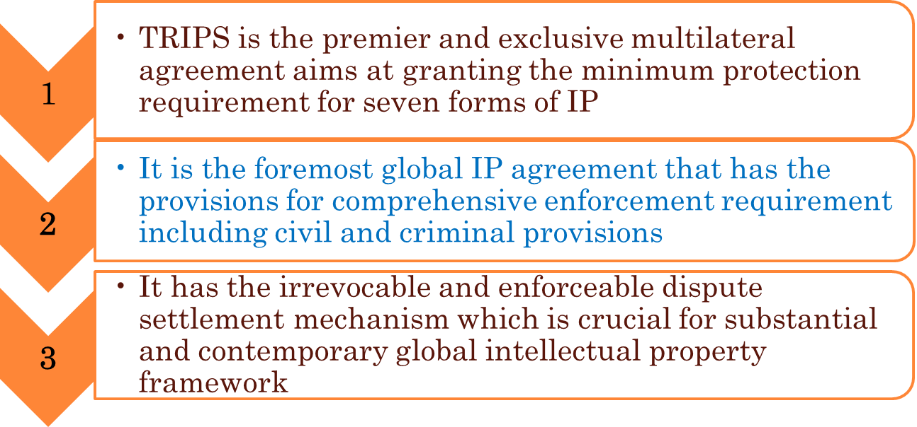
SIGNIFICANCE OF THE TRIPS

Slide 20
BROADER ISSUES OF TRIPS
Sr. No. | Issues
1 | To apply the fundamental principles of the trading arrangement and other international agreements on IP
2 | Adequate protection of IPR
3 | Enforcement of intellectual property rights effectively in other countries
4 | Dispute settlement on IP between the WTO members
5 | Transitional provisions when the new system is being introduced

Slide 21
LIMITATIONS OF THE TRIPS
The TRIPS Agreement is three decades old, it does not address several new developments
The Internet and digital copyright issues, AI etc.
Advanced biotechnology
International harmonization
The process of creating uniform global standards of laws or practice
It determines the floor and not the ceiling for minimum intellectual property rights protection

Slide 22
THE DOHA ROUND
Geographical Indications (GI): Multilateral registration for wines and spirits
Doha Round negotiations included this single IP issue
It aims at protecting wines and spirits in the participating countries
The talks were started in 1997 and were included in the Doha Round in 2001

Slide 23
DOHA ROUND…
Other intellectual property issues
Few members of the WTO liked consultation on two other issues and to associate these to the register for wines and spirits. Other members however, disagreed on this issue.
GI-extension
Stretching the greater degree of protection for GI apart from wines and spirits
Bio-piracy, benefit sharing and traditional knowledge
In May 2024, WIPO member states adopted the first WIPO Treaty to address the interface between intellectual property, genetic resources and traditional knowledge.

Slide 24
DOHA ROUND…
In order to implement the Agreement on Trade-Related Aspects of Intellectual Property Rights (TRIPS) on patent and undisclosed information requirement, extra ten years were granted to the LDCs, because they are related to pharmaceuticals

Slide 25
CONCLUDING OBSERVATIONS
There is a need for IPR protection
Besides Berne, Paris, and Rome conventions on different aspects of IP, there remained a lack of proper and adequate legal and binding framework for the protection of intellectual property
TRIPS was mandated to fill that gap

Slide 26
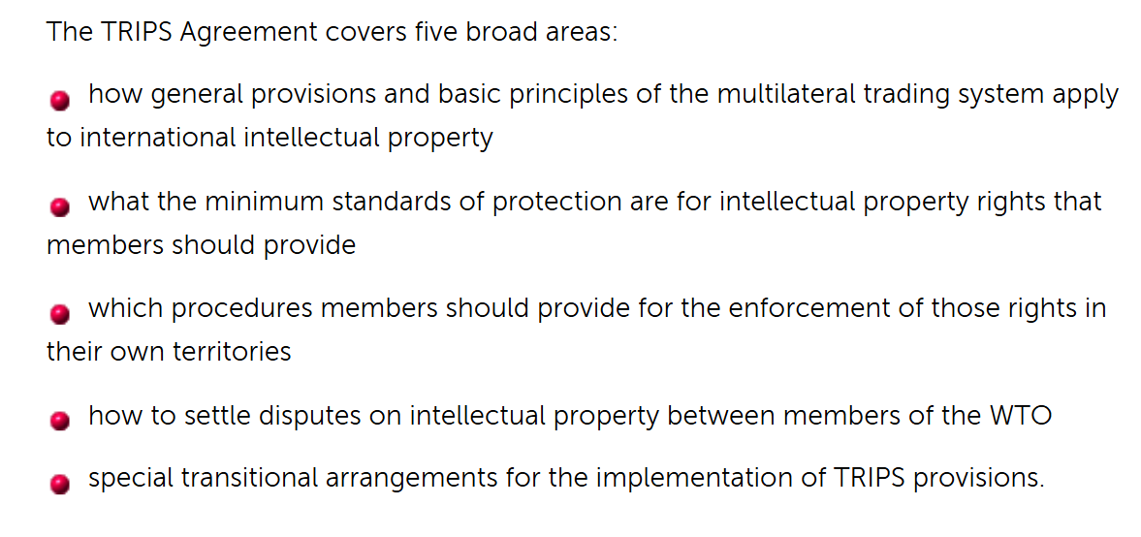
FURTHER READING
https://www.wto.org/english/thewto_e/whatis_e/tif_e/agrm7_e.htm

